Slide 1
Unit 2: Stack
Presented By
Jendi Bade Shrestha,
ME Computer
jendibade@gmail.com
9851125364

Slide 2
Linear Data Structure
It is data structure in which elements are arranged in linear order
Data items can be traversed in a single run
Elements are accessed or placed in contiguous memory locations

Slide 3
Stack
It is a linear data structure which follows a particular order in which the operations are performed.
It follows LIFO(Last In First Out) principle
last thing we added(pushed) is the first that gets pulled(popped) off
It is a abstract data type
The data items are accessed at only one end of the sequence.

Slide 4
A stack is an Abstract Data Type (ADT), commonly used in most programming languages.
It is named stack as it behaves like a real-world stack,
for example – a deck of cards or a pile of plates, etc.

Slide 5



Fig: stack

Slide 6
A real-world stack allows operations at one end only.
For example, we can place or remove a card or plate from the top of the stack only.
Likewise, Stack ADT allows all data operations at one end only.
At any given time, we can only access the top element of a stack.

Slide 7
This feature makes it LIFO data structure. LIFO stands for Last-in-first-out.
Here, the element which is placed (inserted or added) last, is accessed first.
In stack terminology, insertion operation is called PUSH operation and removal operation is called POP operation

Slide 8
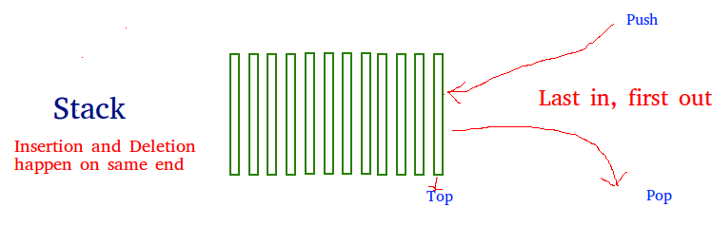

Slide 9
Data Structure
Let’s demonstrate it using animation:
https://www.youtube.com/watch?v=1SWr7q121gc

Slide 10
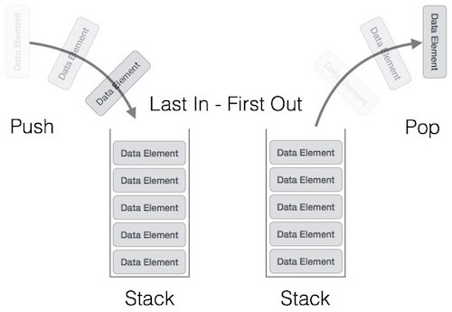
Stack Representation

Slide 11
A stack can be implemented by means of Array, Structure, Pointer, and Linked List.
Stack can either be a fixed size one or it may have a sense of dynamic resizing.
Here, we are going to implement stack using arrays, which makes it a fixed size stack implementation.

Slide 12
Basic Operations
The two primary stack operations are:
push() − Pushing (storing) an element on the stack.
pop() − Removing (accessing) an element from the stack.

Slide 13
Push Operation
The process of putting a new data element onto stack is known as a Push Operation.
Push operation involves a series of steps −
Step 1 − Checks if the stack is full.
Step 2 − If the stack is full, produces an error and exit.
Step 3 − If the stack is not full, increments top to point next empty space.
Step 4 − Adds data element to the stack location, where top is pointing.
Step 5 − Returns success.

Slide 14
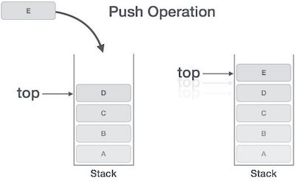

Slide 15
Pop Operation
Accessing the content while removing it from the stack, is known as a Pop Operation.
In an array implementation of pop() operation, the data element is not actually removed, instead top is decremented to a lower position in the stack to point to the next value.
But in linked-list implementation, pop() actually removes data element and deallocates memory space.

Slide 16
Pop operation steps
Step 1 − Checks if the stack is empty.
Step 2 − If the stack is empty, produces an error and exit.
Step 3 − If the stack is not empty, accesses the data element at which top is pointing.
Step 4 − Decreases the value of top by 1.
Step 5 − Returns success.

Slide 17
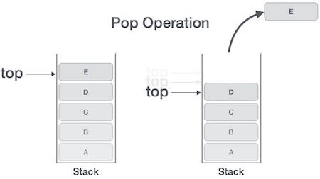

Slide 18
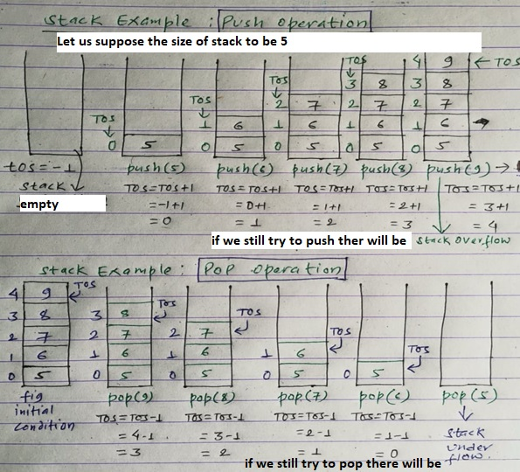

Slide 19
Algorithm of stack:
Step 1: Declare necessary variables
E.g. size=10, TOS= -1, stack[size]
Step 2: for “Push Operation”
Check stack is full or not
if (stack is full) i.e TOS=size-1
Display "Stack Overflow”
else i.e stack is not full
Read the data/element to be stored
Increase TOS by 1 i.e. TOS==TOS+1
stack[TOS]=new data

Slide 20
Step 3: for “Pop Operation”
Check stack is empty or not
if (stack is empty) i.e TOS<0
Display "Stack Underflow”
else i.e stack is not empty
Display value of stack[TOS]
Decrement TOS by 1 i.e. TOS=TOS-1
Step 4: Repeat step 2 and 3 according to the user’s choice.
Step 5: Stop.

Slide 21
Stack as an ADT
It is LIFO data structure

Slide 22
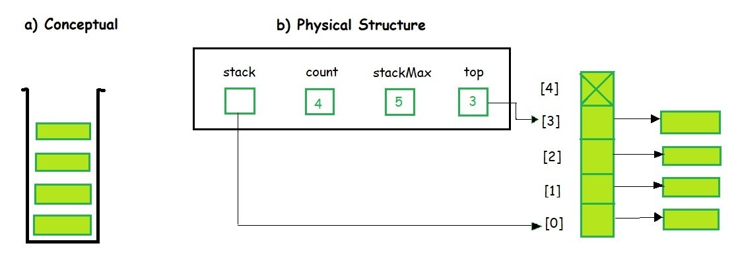

Slide 23
Stack ADT Operations
It contains elements of the same type arranged in sequential order. All operations take place at a single end that is top of the stack and following operations can be performed:
push() – Insert an element at one end of the stack called top.
pop() – Remove and return the element at the top of the stack, if it is not empty.
peek() – Return the element at the top of the stack without removing it, if the stack is not empty.
size() – Return the number of elements in the stack.
isEmpty() – Return true if the stack is empty, otherwise return false.
isFull() – Return true if the stack is full, otherwise return false.

Slide 24
Data Structures: Stack (Abstract Data Type) - YouTube

Slide 25
Stack Applications
Expression evaluation such as Infix to Postfix /Prefix conversion
Redo-undo features at many places like editors, Photoshop.
Forward and backward feature in web browsers
Used in many algorithms like Tower of Hanoi, tree traversals, stock span problem, histogram problem.

Slide 26
Backtracking is one of the algorithm designing technique
Some example of back tracking are Knight-Tour problem, N-Queen problem, find your way through maze and game like chess or checkers in all this problems we dive into someway
if that way is not efficient we come back to the previous state and go into some another path
To get back from current state we need to store the previous state for that purpose we need stack.

Slide 27
In Graph Algorithms like Topological Sorting and Strongly Connected Components
In Memory management any modern computer uses stack as the primary-management for a running purpose.
Each program that is running in a computer system has its own memory allocations

Slide 28
String reversal is also a another application of stack.
Here one by one each character get inserted into the stack.
So the first character of string is on the bottom of the stack and the last element of string is on the top of stack.
After Performing the pop operations on stack we get string in reverse order .

Slide 29
Infix to postfix expression conversion is also a another application of stack.
https://youtu.be/RY4GkLahbCI
https://youtu.be/w-seAp8g42Q
https://www.youtube.com/watch?v=ZIKy8V_FCk8
https://youtu.be/PAceaOSnxQs

Slide 30
1.(A+B)*(C+D)/E-F
= AB+ * CD+ /E-F
=AB+CD+* /E-F
=AB+CD+*E/ - F
= AB+CD+*E/F-

Slide 31
IV) A-B/(C*D$E)
= A-B/(C*DE$)
=A-B/CDE$*
= A-BCDE$*/
=ABCDE$*/-

Slide 32
input | Stack | Postfix
( | (
A | ( | A
+ | (+ | A
B | (+ | AB
) |  | AB+
* | * | AB+
( | *( | AB+
C | *( | AB+C
+ | *(+ | AB+C
D ) / E - F | *(+ * / / - | AB+CD AB+CD+ AB+CD+* AB+CD+*E AB+CD+*E/ AB+CD+*E/F-
(A+B)*(C+D)/E-F
*

Slide 33


